Slide 1




Takeoff Tracker
LEAVE REQUIEST MANAGEMENT APP
Streamlining Leave Requests for Employees and Managers
Presented by Sneha P

Slide 2


Agenda
01
02
03
04
05
06
07
Introduction
Why New Software?
System Architecture
Key Features
Technologies Used
Future Scope
Conclusion

Slide 3

Introduction
Leave Request Management App Features
Easy and fast leave request submission for employees and managers.
Admin and mangers can quickly approve or reject requests.
Leave Count.

Slide 4



Why New Software ?
Current leave management processes are often manual and inefficient.
Challenges include tracking leave requests, managing approvals, and maintaining records.
Gmail

Slide 5
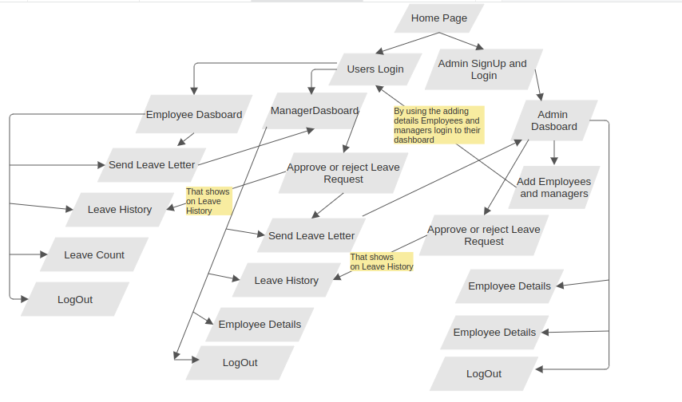
System Architecture

Slide 6

Key Features
01
Users Authentication
02
Admin Dashboard
03
Employee Dashboard
04
Manager Dashboard

Slide 7

Technologies
Frontend:
Built with React and styled with Tailwind CSS.
Backend:
Express and Node JS.
Database:
MongoDB for storing leave requests and user data.
Containerization:
Docker for deploying the application.

Slide 8
Future Scope
01
Leave Balance Tracking
02
Chat System for Communication

Slide 9



Conclusion
Efficiently manage leave requests and approvals with a user-friendly interface.
Supports distinct roles for admins, employees, and managers.
Automated email notifications for new user credentials
Enhanced Clarity and Security
Plans for implementing Leave Balance Tracking and a Chat System for real-time communication between users.

Slide 10
Thank You!
Everest Cantu

